Slide 1
Executive Recommendations for Xenco’s Information Security & Privacy Policies
Enhancing Authentication, Intellectual Property Management, and Technical Security
Presented by: Antonio Seen
Date: 3/12/2025
Notes:
Good morning/afternoon, everyone.
Thank you all for being here today. We appreciate the opportunity to present our recommendations for strengthening Xenco’s information security and privacy policies. As we all know, protecting sensitive corporate data is more important than ever. With the increasing risks of cyber threats, unauthorized access, and intellectual property theft, companies must take proactive steps to secure their systems and information.
Today, we’re going to focus on three key areas that are essential for improving Xenco’s security framework. First, we’ll discuss authentication mechanisms, and how we can strengthen access controls to ensure that only authorized users have access to critical systems. Next, we’ll cover intellectual property management and the best ways to safeguard Xenco’s proprietary information from leaks or misuse. Finally, we’ll explore technical solutions that can enhance corporate data security and protect the company from evolving cyber threats.
By putting these strategies in place, Xenco can create a more secure system that reduces risks and follows the best practices in the industry.
So, let’s get started with our first topic: authentication mechanisms.

Slide 2
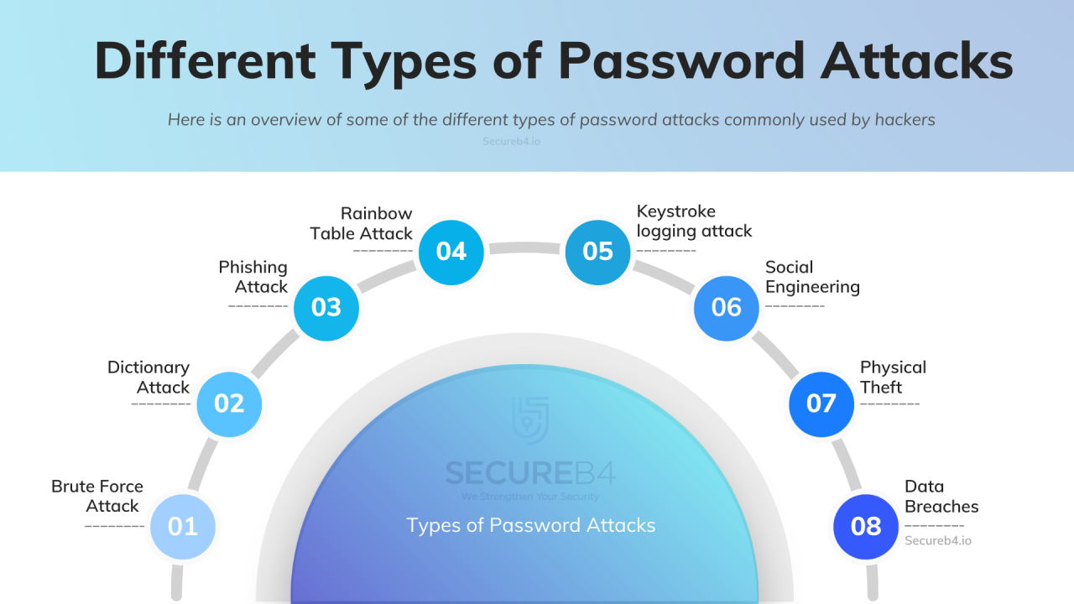
Overview of Authentication Mechanisms
Key Points:
Current reliance on password-only systems exposes Xenco to security vulnerabilities (NIST, 2023).
Risks include phishing, credential stuffing, and brute-force attacks (Okta, 2023).
Need for multi-factor authentication (MFA) or biometric authentication.
Notes:
As we move into the topic of authentication, it’s important to recognize that password-only systems are a major vulnerability. With so many data breaches happening, user credentials are often exposed, putting the company at significant risk. When we rely solely on passwords, it’s easier for unauthorized users to gain access to sensitive information. That’s why we’re suggesting multi-factor authentication (MFA) as a key upgrade. MFA adds an extra layer of protection, making it much more difficult for hackers to get through and having it so that only the right people can access Xenco’s digital assets.
Now, let’s take a closer look at why MFA is so important and how it can help keep the company’s data safe.

Slide 3
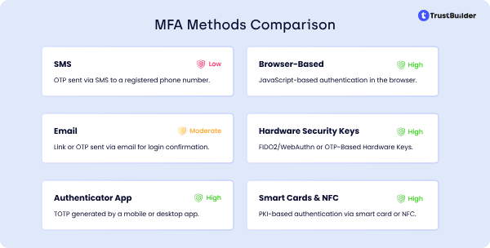
Recommended Authentication Solution
Solution: Implement Okta Adaptive Multi-Factor Authentication (MFA)
Justification:
Uses AI-based risk detection and adaptive authentication. (Okta, 2023)
Supports biometrics (fingerprint/face recognition), push notifications, and one-time passcodes (OTP).
Offers phishing-resistant authentication methods such as FIDO2 security keys.
Ensures seamless integration with Xenco’s existing cloud-based applications and VPNs.
Provides user-friendly authentication with minimal disruption to workflows. (e.g., FIDO2 security keys) (Microsoft, 2023)
Notes:
One great option for implementing MFA is Okta Adaptive MFA. This system boosts security by requiring multiple authentication factors, making it much harder for attackers to gain access, even if they manage to steal user credentials. What makes Okta’s solution stand out is that it adapts the authentication process based on the user's behavior. For example, if it recognizes low-risk login attempts, it keeps things simple. But for higher-risk activities, it enforces stricter verification steps.
What’s also great about Okta Adaptive MFA is that it supports phishing-resistant methods, like FIDO2 security keys, which meet the NIST 800-63B guidelines for secure authentication. This approach not only makes Xenco’s systems more secure but also helps protect against modern threats like phishing attacks.

Slide 4
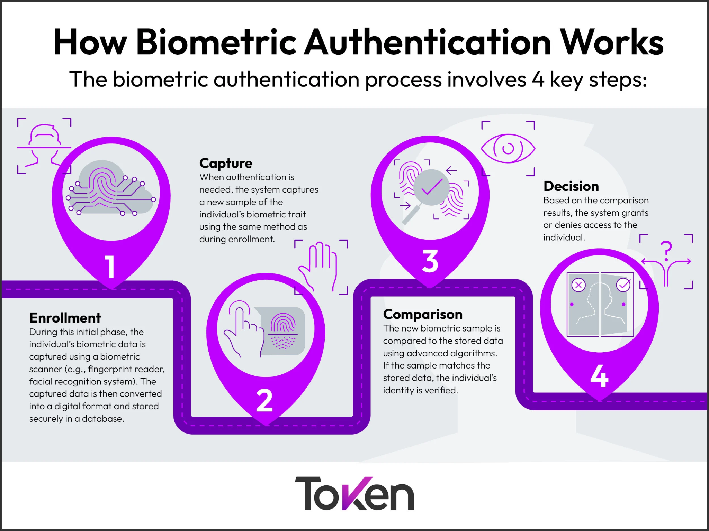
Implementation Plan for Authentication Solution
Steps for Deployment:
Employee Training & Security Awareness: Educate employees on MFA benefits and best practices to ensure smooth adoption.
Policy Configuration & Integration: Set up Okta MFA policies and integrate with Single Sign-On (SSO) systems, VPNs, and key enterprise applications.
Phased Rollout Strategy: Begin deployment with high-risk departments (e.g., finance, engineering) before expanding organization-wide.
Monitoring & Continuous Improvement: Track adoption rates, user feedback, and security metrics, fine-tuning policies as needed.
Notes:
To make the transition easier, we recommend rolling out MFA in phases. This way, we can focus on the most important areas first, reducing security risks as we go. It's also crucial to provide user training throughout this process. One potential issue is push fatigue, where employees might start approving MFA requests without thinking. This could lead to security lapses, so we need to make sure everyone understands how to properly use the system.
By keeping track of user behavior and gathering feedback, we can adjust our policies as needed to make sure we're maintaining the right balance between security and ease of use.

Slide 5
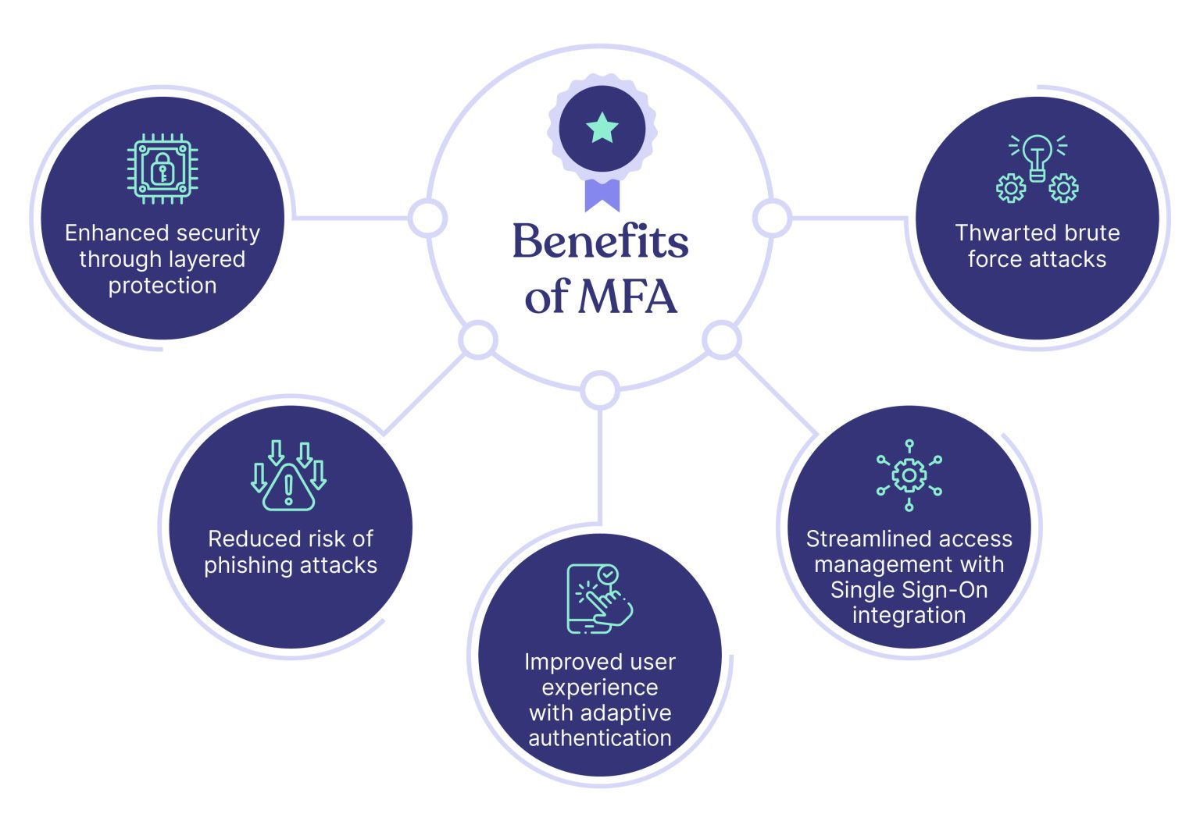
Additional Security Benefits of MFA
Key Benefits:
Mitigates phishing and credential theft risks (NIST, 2023).
Enhances compliance with security frameworks (e.g., NIST, ISO 27001).
Reduces reliance on passwords, lowering attack vectors.
Improves user experience through adaptive authentication (Microsoft, 2023).
Notes:
MFA doesn’t just boost security; it also helps with knowing that we all are meeting industry standards and staying fully compliant with regulations. With adaptive authentication, we can customize the level of security based on the risk level of each user or activity. This way, we don’t overwhelm users with unnecessary steps, but still keep critical assets safe with the right level of protection when needed.

Slide 6

Managing Intellectual Property at Xenco
Challenges:
Lack of a structured IP audit process. (WIPO, 2022)
Potential risk of IP theft or mismanagement.
Need for improved tracking of patents, trademarks, and copyrights.
Notes:
Without a solid IP audit, Xenco could lose track of its valuable intellectual property, leaving proprietary technologies and innovations vulnerable. By implementing a clear framework for IP management, we can better protect these assets and ensure they’re properly safeguarded. Let’s take a look at how an IP audit can help identify areas of weakness and lay out a strategy to strengthen our approach to intellectual property moving forward.

Slide 7
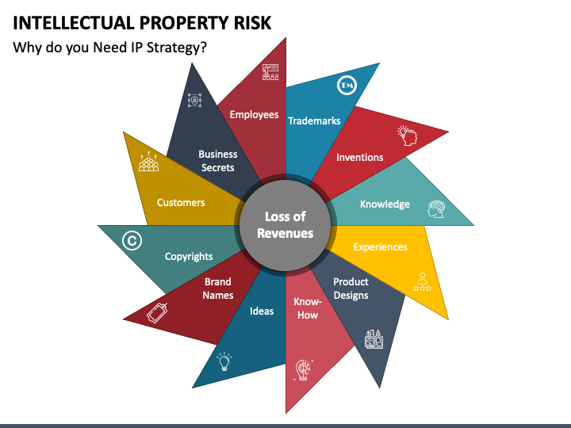
Implementing an IP Audit with WIPO Tool
WIPO Tool Overview:
Provides structured guidance on IP asset management. (WIPO, 2022)
Covers patents, trademarks, trade secrets, copyrights, and contracts.
Helps assess legal risks and international compliance.
Notes:
To effectively assess and manage IP risks, we can turn to the World Intellectual Property Organization (WIPO) for assistance, which offers a comprehensive tool for evaluating and protecting intellectual property. By using this tool, Xenco can systematically review its IP portfolio, so that all key innovations are properly documented, owned, and securely protected. This approach will help identify any gaps and strengthen our overall IP strategy moving forward.

Slide 8
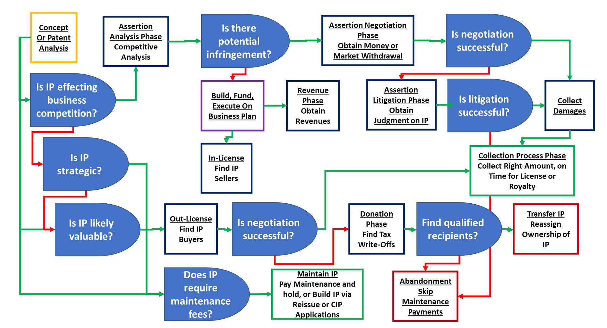
Key Sections of WIPO IP Audit Report
Identification of IP assets
Ownership verification
Patent status review
Trademark portfolio assessment
Copyrighted materials inventory
Trade secret protections
Licensing agreements review
International compliance
Risk assessment
Recommendations for policy improvements
Notes:
For a comprehensive IP strategy, it’s crucial that we conduct a thorough IP audit covering all ten key areas outlined in the WIPO framework. This detailed process makes sure that every piece of intellectual property is not only accounted for, but also properly protected and strategically managed. By addressing these areas, we can identify potential risks and strengthen Xenco’s position, safeguarding against both legal challenges and security threats.

Slide 9
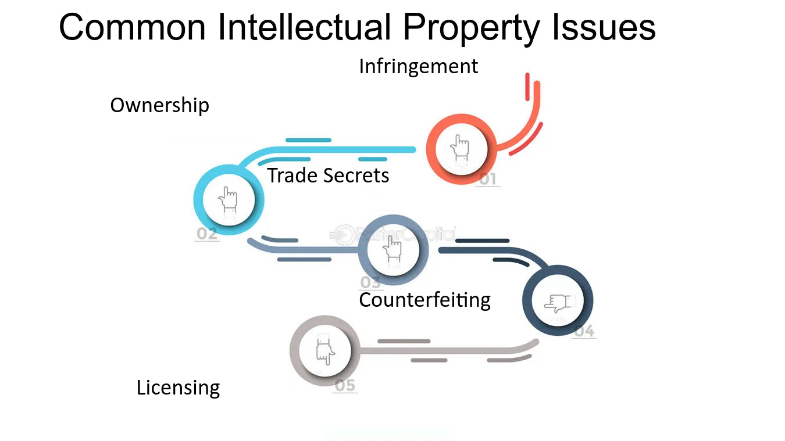
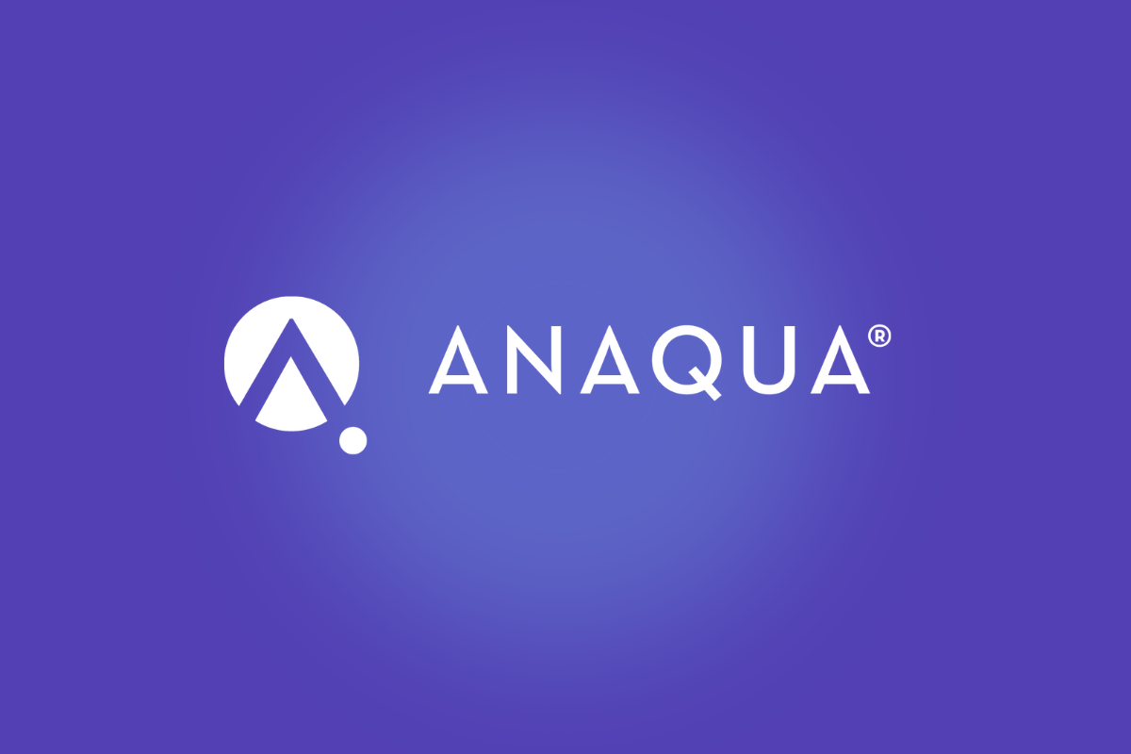
Top IP Issues and Recommended Solutions
Issues:
Lack of documented IP ownership structure.
Insufficient protections for trade secrets.
Limited IP enforcement mechanisms internationally.
Recommendations:
Implement digital IP tracking software (e.g., Anaqua IPMS).
Create an internal IP enforcement team.
Strengthen international compliance measures.
Notes:
To tackle these challenges, we recommend a few key steps to strengthen Xenco’s IP management. First, we suggest investing in digital tracking software, like Anaqua IPMS, to help keep track of IP ownership and ensure everything is documented properly. This will minimize the risk of disputes and help protect your intellectual assets.
Next, creating an internal IP enforcement team will allow Xenco to respond quickly if any violations arise and help safeguard your innovations. This team will also play a key role in monitoring IP compliance across the company.
Finally, we recommend enhancing international compliance measures. Strengthening protections across borders is crucial as Xenco expands, ensuring that your intellectual property is well protected globally.

Slide 10
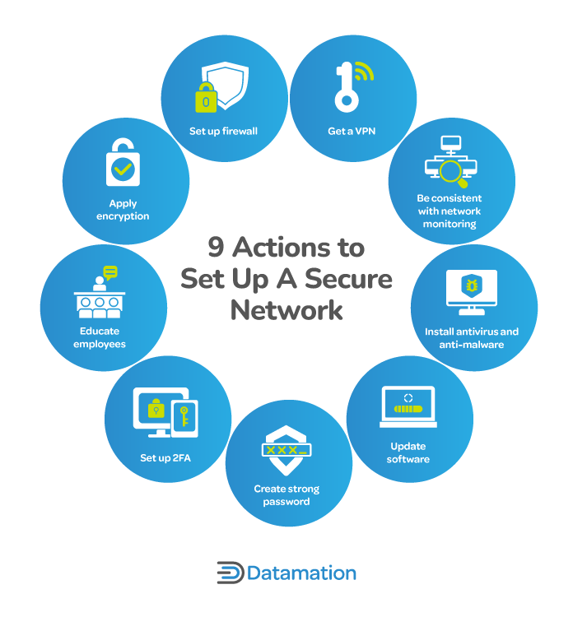
Securing Corporate Data and IP
Challenges:
Unauthorized access to sensitive data particularly through weak points in the system, remains a critical threat to Xenco’s security.
Weak encryption policies (Microsoft, 2023) expose data to potential interception during transfers and storage, increasing the likelihood of breaches.
Lack of visibility into data transfers makes it harder to track and control where sensitive information is moving, leaving the company vulnerable to data leaks and unauthorized sharing.
Notes:
In addition to authentication and IP management, it’s crucial that we focus on securing Xenco's corporate data. Unauthorized access and weak encryption are significant risks that could result in data breaches. Without proper safeguards in place, sensitive information could be exposed. By strengthening access controls and improving encryption practices, we can better protect Xenco’s data from both internal and external threats.

Slide 11
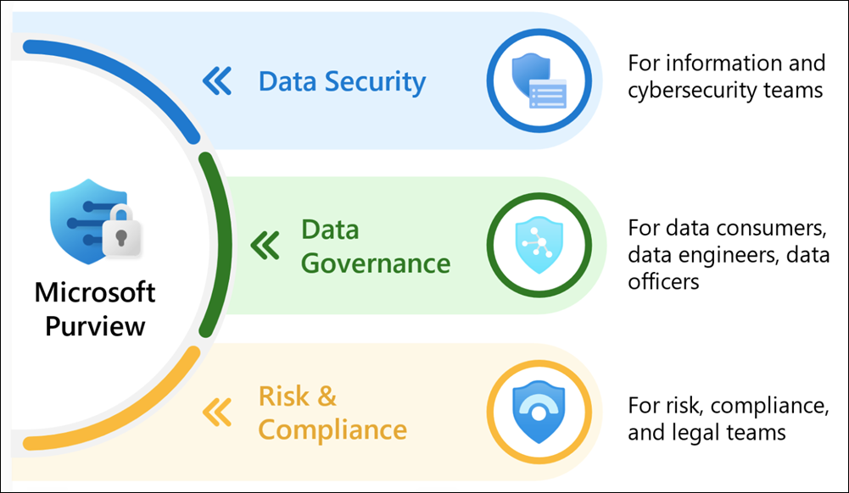
Recommended Data Security Solution
Solution: Implement Microsoft Purview for Data Loss Prevention (DLP)
Justification:
Provides real-time monitoring and data classification.
Prevents unauthorized sharing of sensitive data. (Microsoft, 2023)
Ensures compliance with global privacy regulations.
Notes:
To address these data security challenges, I, along with many other companies, recommend Microsoft Purview as a solution. It offers a comprehensive system to monitor and prevent data leaks, which is essential for maintaining the integrity of Xenco’s sensitive information. By implementing Microsoft Purview, not only can we strengthen Xenco’s security but also ensure full compliance with industry regulations, ultimately protecting both the company and its data from potential breaches.

Slide 12
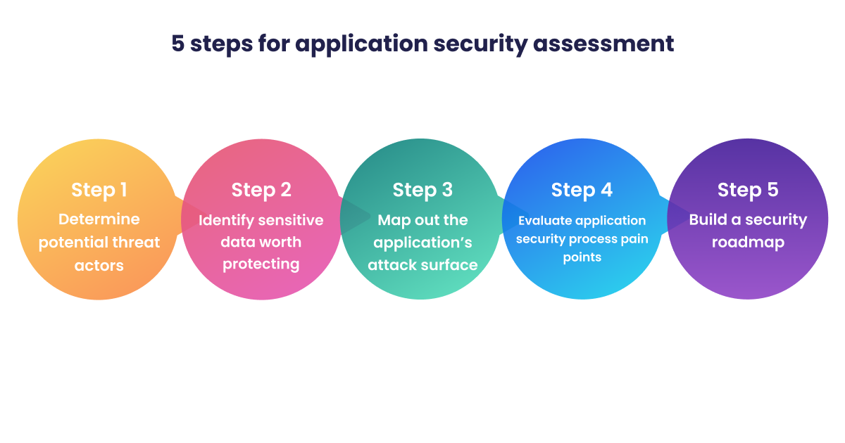
Implementation Plan for Data Security
Steps for Deployment:
Conduct a data security assessment.
Configure Microsoft Purview for critical data assets.
Establish access control policies and encryption.
Monitor compliance and refine policies as needed.
Notes:
To make sure that a smooth integration of Microsoft Purview takes place, I recommend a step-by-step approach. This will allow Xenco to effectively implement the system without disrupting day-to-day operations. By carefully planning each phase, from setup to monitoring, I can ensure you all that sensitive data is well protected while maintaining operational efficiency throughout the process.

Slide 13

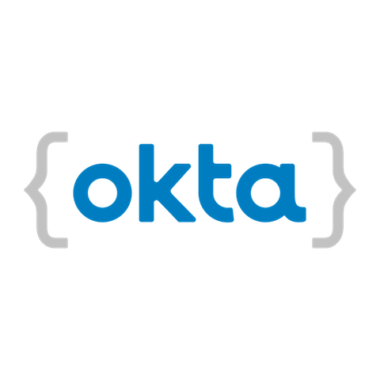

Summary of Recommendations
Key Takeaways:
Implement Okta Adaptive MFA for secure authentication.
Conduct an IP audit using WIPO’s framework.
Strengthen IP protections through digital tracking and compliance.
Deploy Microsoft Purview for enhanced data security.
Notes:
By using these recommendations, Xenco will significantly improve its overall security, enhance IP management, and better protect sensitive data from potential breaches or leaks. Strengthening authentication, reinforcing IP protections, and securing corporate data will help Xenco stay ahead of emerging threats. These strategies not only address current vulnerabilities but also set the company up for long-term success, making sure that its digital assets are well-protected as the company continues to grow.

Slide 14
Conclusion
Final Thoughts:
Strengthening security enhances business resilience.
Implementing MFA, IP protection, and DLP safeguards critical assets.
Continuous monitoring and adaptation are key for long-term security.
Notes:
To wrap it all up, by implementing these strategies, Xenco will be in a stronger position to protect against cybersecurity threats and safeguard its intellectual property. In today’s digital world, staying proactive is necessary, and these measures will ensure that Xenco is well-prepared. Thank you all for your time!

Slide 15
Additional Resources
NIST Cybersecurity Framework https://www.nist.gov/cyberframework
WIPO IP Management Guide https://www.wipo.int/edocs/mdocs/sme/en/wipo_ip_bis_ge_03/wipo_ip_bis_ge_03_24-related1.pdf
Microsoft Purview Data Protection Documentation https://learn.microsoft.com/en-us/purview/purview
Okta Adaptive MFA Whitepaper https://www.okta.com/resources/whitepaper/how-adaptive-mfa-helps-mitigate-brute-force-attacks/

Slide 16
References
National Institute of Standards and Technology (NIST). (2023). Cybersecurity framework. https://www.nist.gov/cyberframework
Okta. (2023). Adaptive MFA security. https://www.okta.com/products/adaptive-multi-factor-authentication/
Microsoft. (2023). Data loss prevention guide. https://www.microsoft.com/purview
WIPO. (2022). Intellectual property audit guide. https://www.wipo.int

